Slide 1

Relationships between
IQ Levels & Socioeconomic Factors
CSC 302 - Data Visualization Midterm Project
Amy Brown, Angela Morgan, Tayler Harms
Notes:
Amy -
My name is Amy Brown. Together with my group members, Angela Morgan and Tayler Harms, we are presenting our midterm presentation for CSC 302 Data visualization.
We chose a dataset that explores the relationship between average IQ levels and various socioeconomic factors across different countries around the world

Slide 2
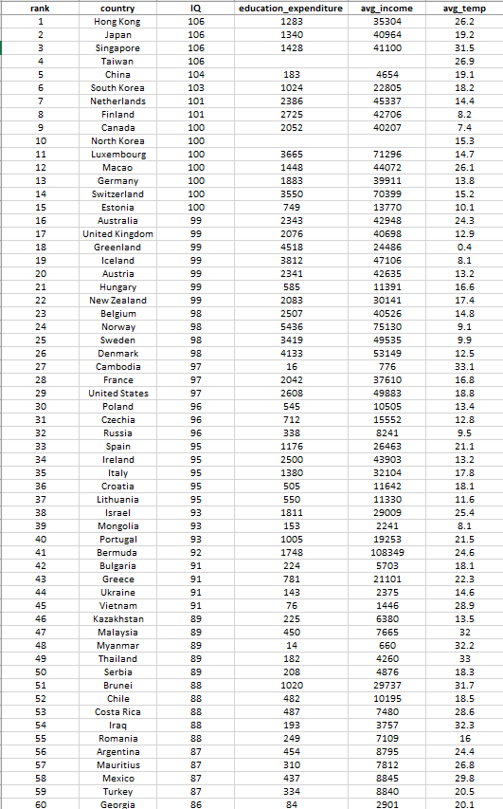
Our Data
Worldwide Average IQ Levels
Country
IQ
The average IQ score for the population
Education Expenditure
The amount of money spent on education in the country (in US dollars)
Average Income
The average income in the country (in US dollars)
Average Temperature
Celsius
Notes:
Amy-
The dataset included:
108 countries around the world
the average IQ scores for the population of each of those countries
Education expenditure: or the amount of money in US dollars that was spent on education in the country
The average income in the country, also in US dollars
And finally, the average temperature in the country, in celsius

Slide 3
Questions We Asked
Is there a correlation between the average income and IQ level?
Is there a correlation between the education expenditure and the average IQ level?
Is there a correlation between the average income, average education expenditure and average IQ level?
Is there a correlation between the country, average temperature, and the average IQ level?
What is the distribution of average IQ scores across different continents?
Notes:
Amy:
The questions we asked with the dataset were:
Is there a correlation between the average income and IQ level?
Is there a correlation between the education expenditure and the average IQ level?
Is there a correlation between the average income, average education expenditure and average IQ level?
Is there a correlation between the country, average temperature, and the average IQ level?
What is the distribution of average IQ scores across different continents?

Slide 4
Q1 Income & IQ level
Is there a correlation between the average income and IQ level?
Inference:
We believe that average IQ impacts income, and expect to see higher IQs associated with higher incomes, and lower IQs associated with lower incomes.
Visualization choice:
We chose a bar plot for average IQ, with a line plot for income on dual axes for relationship comparison.
X axis = Country
Y axis = Average Income
Y axis (secondary) = Average IQ
Notes:
Tayler: As mentioned, our first question was “is there a correlation between the average income and IQ level?”
We made a prediction that the average IQ impacts income and expect to see average IQs increase as incomes increase, and lower IQ associated with lower income.
For our visualization, we chose to use a bar plot to relay our data outcome having the X axis as country, the Y axis as Average Income, and the secondary y axis with average IQ

Slide 5
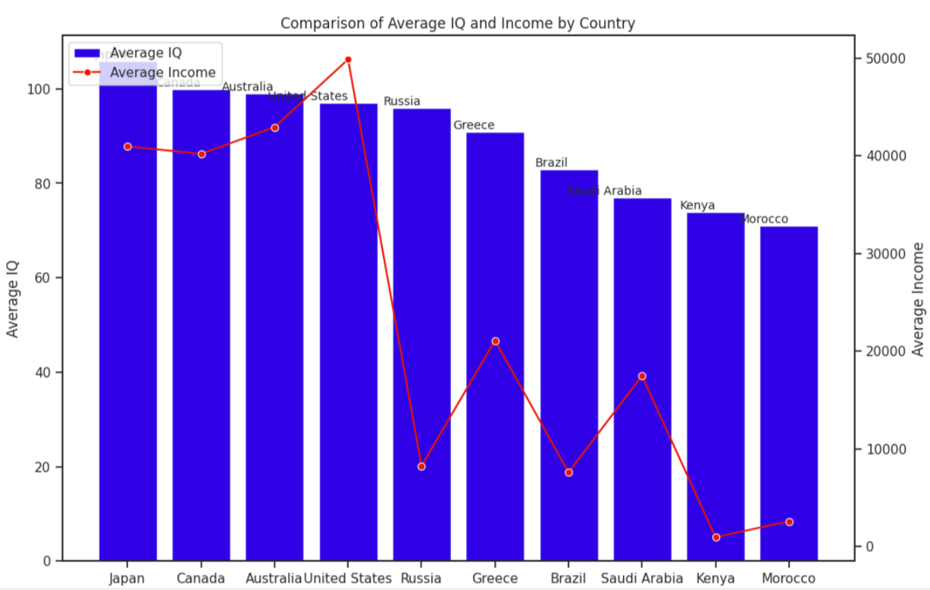
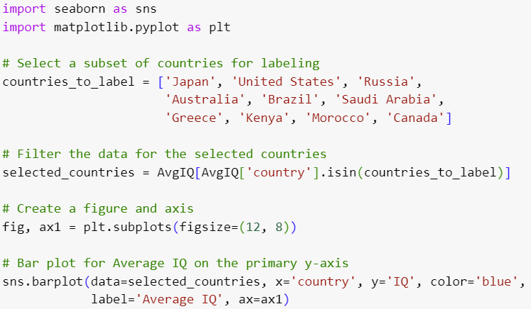
Q1 Visualization
This bar plot with line plot on dual axes allows us to measure relationship of variables with two different scales.
Conclusion: This visualization suggests some correlation between IQ and average income, although possibly not a strong or direct correlation.
Notes:
Tayler: Here is our bar plot visualization result for our first question. This bar plot shows an upward trend demonstrating a positive correlation between average IQ and income.
Needless to say, on average as IQ scores increase, income also tends to increase.

Slide 6
Q2 - Average IQ & Education Expenditure
Is there a correlation between the education expenditure and the average IQ level?
Inference:
We believe that that there will be a positive correlation between education expenditure and average IQ.
Visualization choice:
We chose a scatter plot with a regression line, as it is appropriate for visual inspection and quantifying the correlation strength.
X axis = Education Expenditure
Y axis = Average IQ
Notes:
Angela:

Slide 7
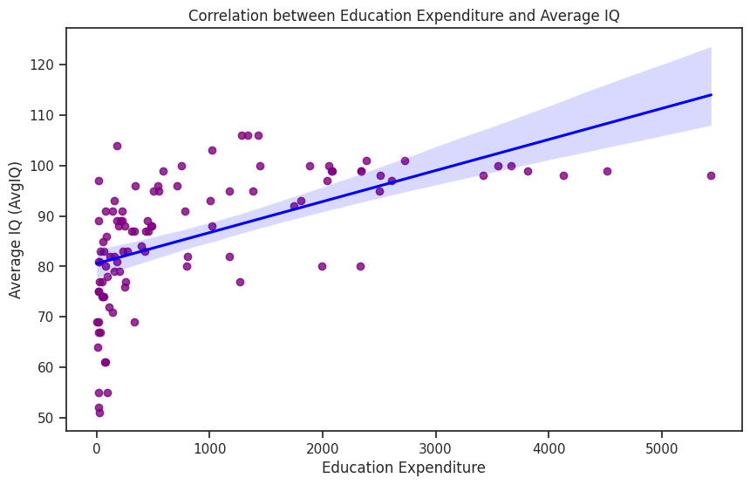
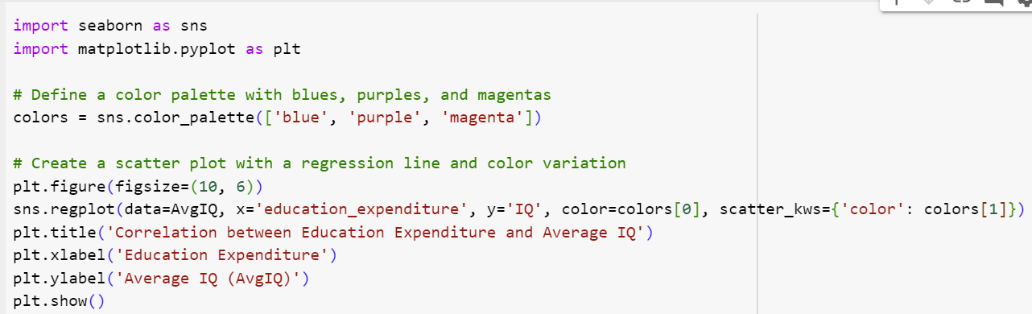
Q2 Visualization
The scatter plot with regression line demonstrates a positive correlation between education expenditure and average IQ.
Conclusion: As education expenditure increases, there is a trend of higher average IQ scores.
That said, correlation does not imply causation.
Notes:
Angela:

Slide 8
Q3 - Income, Education Expenditure, and IQ Level
Is there a correlation between the average income, average education expenditure and average IQ level?
Inference:
We believe that there will be an upward trend, and as the average income increases, the average education expenditure will also increase, as will the average IQ level.
Visualization choice:
We chose a strip plot, a type of categorical scatter plot that helps to visualize the distribution of a variable within different categories.
X axis = Average Income
Y axis = Average IQ Level
Notes:
Amy:
Here the question we asked was…
We believe that…
We chose a strip plot because…

Slide 9
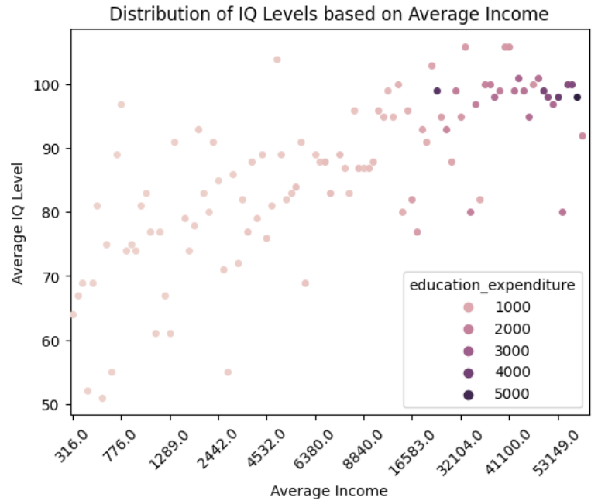
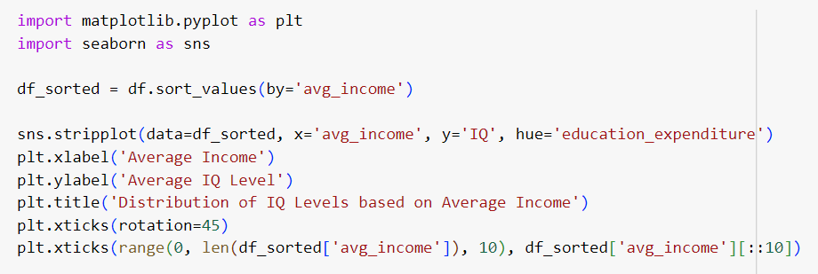
Q3 Visualization
This strip plot shows the distribution of average IQ levels across different average incomes in US dollars, and the hue represents how much money was spent on education.
Conclusion: The general trend is that more money is spent on education as the income level rises. The IQ levels mostly follow the same trend, but there is more variability in the IQ levels with more outliers.
Notes:
Amy

Slide 10
Q4 - Correlation of Temperature and IQ
Is there a correlation between the country, average temperature, and the average IQ level?
Inference:
We believe/expect that there is a correlation between the country, average temperature, and the average IQ level.
Visualization choice:
We chose a scatter plot to show our results of the correlation between these variables.
X axis = Average Temperature
Y axis = Average IQ Level
Notes:
Tayler: For our fourth question we wanted to know is there a correlation between the country, average temperature, and the average IQ level?
We predict that there is a correlation between the country, average temperature and the average IQ level.
We chose to use a scatter plot to show our results of the correlation between these variables having the X axis as average temperature and the Y axis as average IQ level.

Slide 11
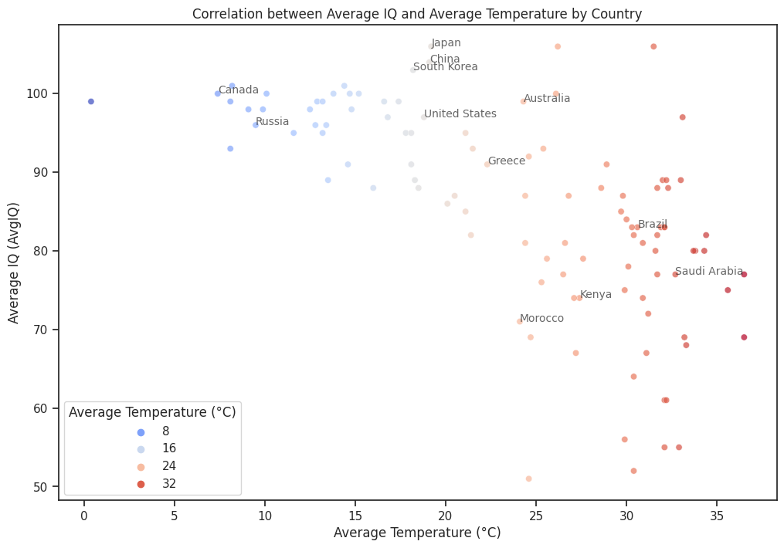
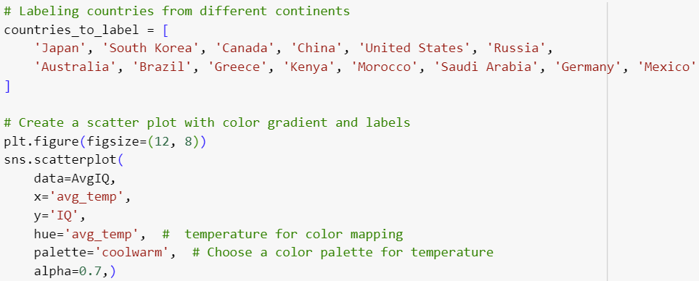
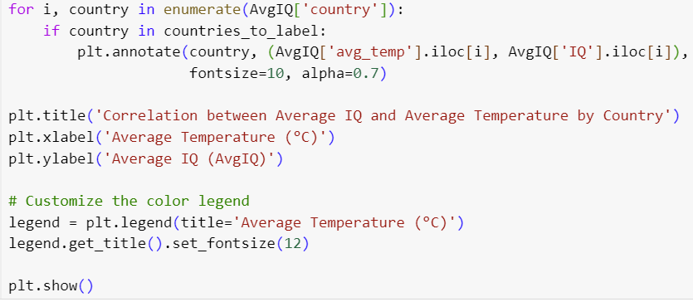
Q4 Visualization
The scatterplot shows the points are scattered across the graph without clear trend or pattern indicating there may not be a strong linear relationship between the average IQ and average temperature by country.
Conclusion: We conclude that there is no correlation between these variables.
Notes:
Tayler: The scatterplot shows the points are scattered across the graph without clear trend or pattern indicating there may not be a strong linear relationship between the average IQ and average temperature by country.
Conclusion: We conclude that there is no correlation between these variables.

Slide 12
Q5 - Distribution of IQ scores across continents
What is the distribution of average IQ scores across different continents?
Reasoning
After observing a cluster of the highest IQs in Asian countries, we wondered about the overall distribution of IQ scores on a continental level.
Visualization choice:
We chose box plots to demonstrate the distribution and variation of average IQs within each continent. The visual inclusion of the range of IQ scores, as well as the median, upper and lower quartiles is particularly useful.
Notes:
Angela:

Slide 13
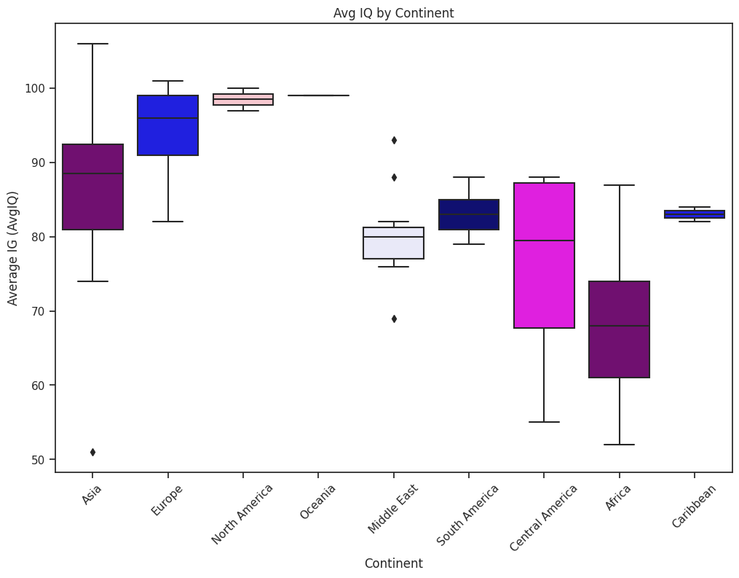
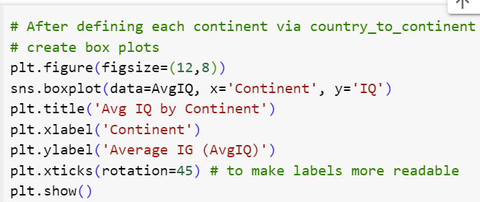
Q5 Visualization
The box plot visualization is both useful and surprising. It shows the distribution of the average IQs grouped by continent, as well as the mean and variability of IQs within each continent.
Conclusion: There is significant variation of Average IQ, per continent. Moreover, significant variation within most of the continents. This visualization could serve as a basis of more detailed research, localized to the continent, where differences of average income and educational expenditure variables could be more meaningful.
Notes:
Angela:

Slide 14
Summary of Findings
There appears to be a positive correlation between income levels and the amount spent on education.
There is some variability with IQ levels and the other socioeconomic factors, but there a slight trend that those with higher average IQ scores had higher average incomes.
There does not appear to be a strong linear relationship between temperature and IQ levels.
There is significant variation in IQ levels by continent.
Although correlations exist, there is not evidence of causation.
Notes:
Tayler: To conclude this study, here we have a summary of our findings,
There appears to be a positive correlation between income levels and the amount spent on education.
There is some variability with IQ levels and the other socioeconomic factors, but there is a slight trend that those with higher average IQ scores had higher average incomes.
There does not appear to be a strong linear relationship between temperature and IQ levels.
Lastly, there is significant variation between IQ levels by continent.

